Slide 1
Mini Game with ML-Driven Difficulty Prediction
University of New Haven

Slide 2



Meet the team
Tanak Patel
Heli sureja
Priyanka Singh

Slide 3
Introduction to Our Game
Game Name: Country & Capital Memory Match
Concept: A memory game where players must match countries with their correct capitals on a 4x4 board. Each game round contains 8 country-capital pairs (16 tiles total).
Game Rules:
The board starts with all tiles face down.
Players select two tiles per turn:
If a Country and its Capital are matched → they stay revealed.
If not → both tiles are flipped back.
The game ends when all pairs are matched.
Priyanka

Slide 4

Game Mechanics
Board is displayed as a 4x4 grid.
Uses random sampling to pick 8 unique pairs from a full CSV of countries & capitals.
Tracks:
Moves made
Time taken
Incorrect attempts
Example Code Features:
Board Setup:
Randomly shuffle country-capital pairs for every new game.
Display Board:
Only matched or currently revealed tiles are shown; others display as “X”.
Game Loop:
Players input their tile choices by index.
Board updates after every move.
Priyanka

Slide 5
Machine Learning Component
Purpose of ML Integration:
To predict the difficulty level of a game session based on user performance data.
Why It Matters:
Makes the game adaptive — it can dynamically assign harder/easier levels next time based on a player’s capability.
Balances fun vs. frustration.
ML Inputs:
Time to solve
Number of moves
Incorrect attempts
Priyanka

Slide 6
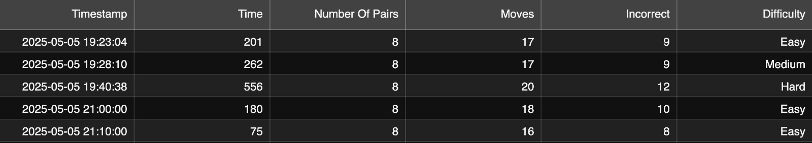
Data Collection & CSV File
How We Record Data:
After each level, we log:
Time taken in seconds
Total moves
Incorrect moves
Label (🟠 Easy/🟠 Medium/🟠 Hard)
Timestamp
Priyanka

Slide 7
Why Random Forest Classifier?
Nonlinear Handling: Game performance metrics are not linear — Random Forest captures complex relationships.
Mixed Data Types: Works well whether data is continuous (time) or discrete (errors).
Outlier Robustness: Players might make mistakes or rush — the model handles noise.
Feature Importance: Shows which metric (Time? Moves?) matters most.
Strong Baseline: Performs well even without a lot of hyperparameter tweaking.
Priyanka

Slide 8
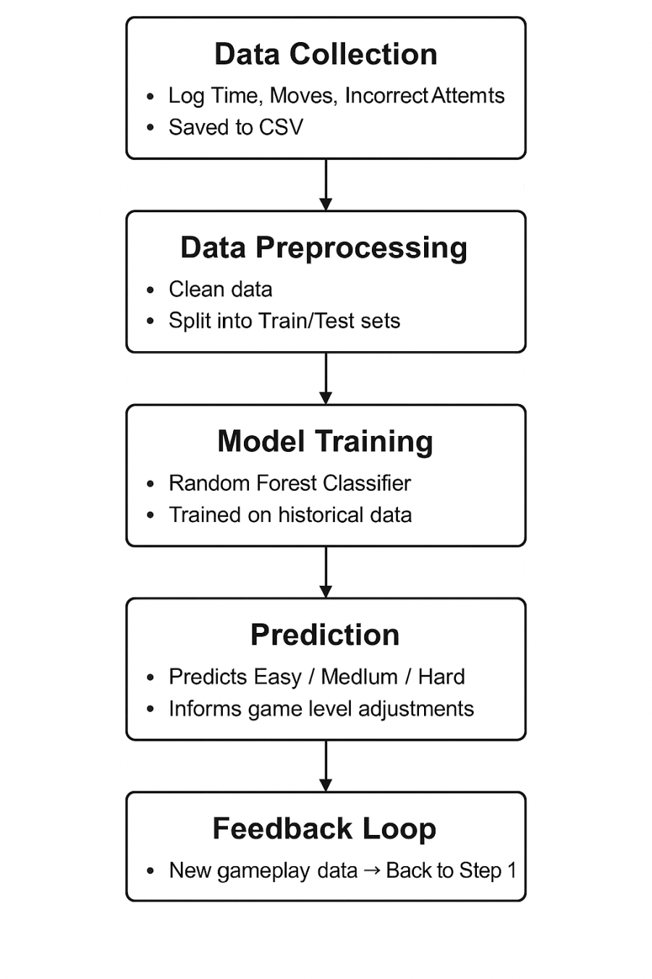
ML Model Workflow
Step-by-Step Flow:
Data Collection: Track user performance (time, moves, incorrects).
Preprocessing: Clean & format the data.
Model Training: Fit Random Forest using our dataset.
Prediction: New game data → Difficulty prediction.
Feedback Loop: Use predictions to refine future levels.
Heli

Slide 9
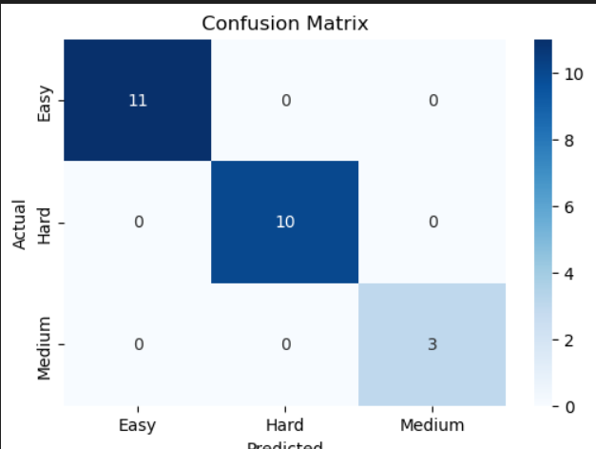
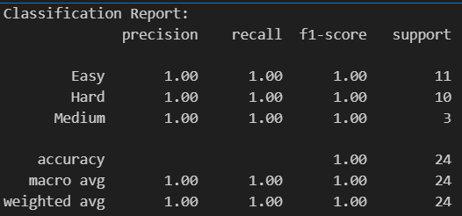
Model Performance & Interpretation
Heli

Slide 10

3Cs - Curiosity
What We Explored:
Different ML models (tested SVM, Logistic Regression).
Gameplay tweaks (timer-only vs. moves + timer).
Found that Random Forest + Time tracking gave best results.
Heli

Slide 11

3Cs - Connections
Integration of Knowledge:
Merged game design, AI modeling, user testing.
Took inspiration from existing games + ML research.
Managed risks by using cross-validation and testing extensively.
Heli

Slide 12

3Cs - Creating Value
Value Delivered:
Unique game that adapts to user skills.
The ML model provides personalized challenge levels.
Learned from failures: Early versions were too hard/easy; we iterated quickly.
Heli

Slide 13
Future Improvements
Multiplayer Mode: Allow players to compete and compare scores.
Leaderboard: Display global high scores and fastest times.
Dynamic Difficulty: Use ML predictions to auto-adjust puzzle complexity for each player.
UI Enhancements: Shift from console-based to a graphical interface (e.g., using Pygame or Tkinter).
More Data Features: Add tracking for player hints used, pause time, increase grid size, etc.
Heli

Slide 14

Why It’s Fun
Challenging: Adaptive difficulty keeps players on their toes.
Fresh: Randomly generated puzzles mean endless variety.
Engaging: Tracks your skill and responds dynamically.
Heli

Slide 15

Thank you!
If you have any questions, please reach us out at :
hsure2@unh.newhaven.edu
psing21@unh.newhaven.edu
tpate17@unh.newhaven.edu
Github link - https://github.com/ml-project-game/ml-project-game
Under Guidance of:
Prof. Mohamed Nassar

